Slide 1
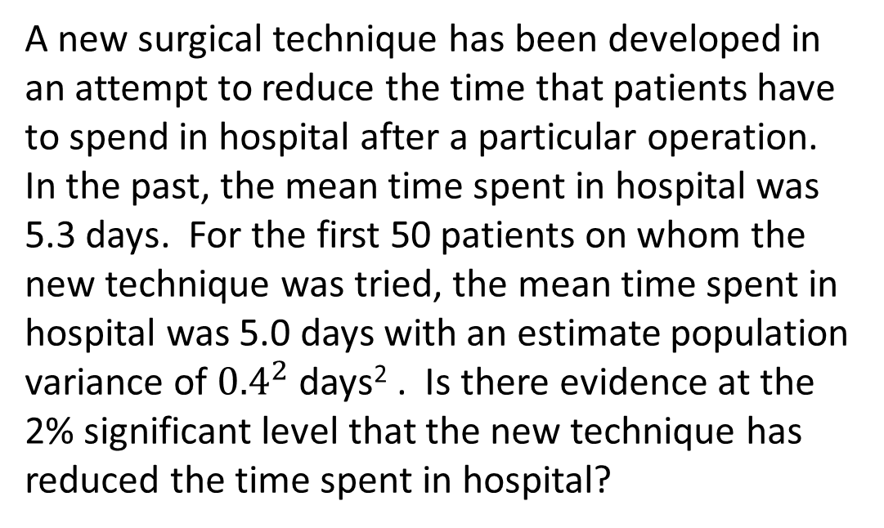

Example 1 Large sample, $σ^{2}$ known (use z-test)
A new surgical technique has been developed in an attempt to reduce the time that patients have to spend in hospital after a particular operation. In the past, the mean time spent in hospital was 5.3 days. For the first 50 patients on whom the new technique was tried, the mean time spent in hospital was 5.0 days with an estimate population variance of ${0.4}^{2}$ days² . Is there evidence at the 2% significant level that the new technique has reduced the time spent in hospital?

Slide 2

Example 2 Large sample, $σ^{2}$ unknown ( use z-test )
An inspector of items from a production line takes, on average, 21.75 seconds to check each item. After the installation of a new lighting system the times, t seconds, to check each of 50 randomly chosen items from the production line are summarised by ∑ t = 1107 and ∑ t² = 24 592.35.
(a) Calculate an unbiased estimate of the population variance of the time to check an item under the new lighting system.
(b) Test at the 5% significant level whether there is evidence that the population mean time has changed from 21.75 seconds.

Slide 3

Example 3 Small sample, $σ^{2}$ known (use z-test )
A test of mental ability has been constructed so that, for adults in Great Britain, the test score is normally distributed with mean 100 and standard deviation 15. A doctor wishes to test whether sufferers from a particular disease differ in mean from the general population in their performance on this test. She chooses a random sample of 10 sufferers. Their scores on the test are
119 131 95 107 125 90 123 89 103 103
Carry out a test at the 5% significant level to test whether the sufferers from the disease differ from the general population in the way which they perform at this test.

Slide 4

Example 4 Small sample, $σ^{2}$ unknown ( use t-test )
Five readings of the resistance X, in ohms, of a piece of wire gave the following results:
1.51 1.49 1.54 1.52 1.54
If the wire is pure, the resistance is 1.50 ohms. If the wire is impure, its resistance is higher than 1.50 ohms. Making any necessary assumptions, calculate
(a) the sample mean
(b) an unbiased estimate of the population variance,
Is there evidence at the 5% level of significance, that the wire is impure?

